Slide 1

Advanced Information Literacy
https://library.uttarauniversity.edu.bd

Slide 2

Research & Search

Slide 3
Presentation Content
To Google or Not to Google
Information Sources
Evaluating Sources
The Research process
Search Strategies
Topic Determination
Concepts
Keywords
Search Techniques
Last words

Slide 4
To Google or
Not to Google
If you have an assignment
you have an assignment to complete or
thesis to write, can
can
you use Google or Wikipedia?
outdated
pages and broken links are common problems, and you can
As initial
initial research tools, they
research tools, they are usually fine.
are usually fine. But
But outdated
seldom be sure whether the information is accurate and
authoritative.
.
To do ‘proper’ research,
you should be using authoritative
sources which can be found in the library, either in print
(eg.
books & journals) or electronic format (eg. e-resources).

Slide 5


















Information Sources
.
E-resources
(Databases etc)
Journal articles
Conference papers
Books
Search
Newspapers
Other internet
sources
Theses
Dissertations
4
4

Slide 6
Evaluating Sources
When evaluating any resource, consider:
Authority
Accuracy
Objectivity
Currency
Coverage

Slide 7
Evaluating Sources
Authority
  O Is there an author? Is the page signed?
  O Is the author qualified? An expert?
  O Who is the sponsor?
  O Is the sponsor of the page reputable? How reputable?
  O Is the sponsor of the page reputable? How reputable?
  O Is there a link to information about the author or the sponsor?
  O If the page includes neither a signature nor indicates a sponsor, is there any other way to determine its origin?

Slide 8
Evaluating Sources
O Authority
  • Rationale
  –Anyone can publish anything on the web.
  –It is often hard to determine a web page's authorship.
  –Even if a page is signed, qualifications are not usually provided.
  –Sponsorship is not always indicated.

Slide 9
Evaluating Sources
O Accuracy
  O Is the information reliable and error-free?
  O Is there an editor or someone who verifies/checks the information?
• Rationale
–Unlike traditional print resources, web resources rarely have editors or fact-checkers.
–Currently, no web standards exist to ensure accuracy.

Slide 10
Evaluating Sources
Objectivity
  O Does the information show a minimum of bias?
  O Is the page designed to sway opinion?
  O Is there any advertising on the page?
• Rationale
  –Frequently the goals of the sponsors/authors are not clearly stated.
  –Often the Web serves as a virtual “Paltan Maidan", a soapbox.

Slide 11
Evaluating Sources
Currency
  O Is the page dated?
  O If so, when was the last update?
  O How current are the links? Have some expired or moved?
• Rationale
–Publication or revision dates are not always provided.
–If a date is provided, it may have various meanings.
For example,
• It may indicate when the material was first written
• It may indicate when the material was first placed on the Web
• It may indicate when the material was last revised

Slide 12
Evaluating Sources
Coverage
What topics are covered?
What does this page offer that is not found elsewhere?
How in-depth is the material?
• Rationale
– Web coverage often differs from print coverage.
– Frequently, it's difficult to determine the extent of coverage of a topic from a web page. The page may or may not include links to other web pages or print references.
– Sometimes web information is "just for fun", a hoax, someone's personal expression that may be of interest to no one, or even outright silliness.

Slide 13
Evaluating Sources
Further consideration:
  O Audience
    Too technical or too elementary
  O Type of source
    Primary/secondary/tertiary
  O Documentation
    Bibliography, footnotes, additional links, viewpoints
  O Use of language
    Standard/ colloquial

Slide 14

















The Research Process
The typical research process looks like this:
Construct search
statement from
your keywords
List keywords
from the
concepts
Break down
your topic into
concepts
Search for materials
such as books &
articles. Use OPAC &
databases. Check if
they are relevant
START
HERE
Your Topic
Locate the
materials in
the library
Complete your
assignment
NO
Find more sources by using
references in the sources
you have located
YES
Do you have sufficient
sources for your
assignment?

Slide 15
Search Strategies
  Determine/summarize the topic
  Select keywords from research question
  Expand your vocabulary using synonyms and related concepts
  Construct search queries based on your keywords
  Identify main concepts
  Check for background information
  Develop a list of keywords and phrases
  Search in databases, on the Internet, in library catalogs
  Keep publication/origination information organized

Slide 16
Topic Determination
The research scope/course/assignment may guide to the choice of a topic
Topic should be as specific as possible
A very broad topic may need narrowing
A very specific topic may need expansion

Slide 17
Topic Determination
For searching
Example 1:
  I want information on how violence on television affects children.
Example 2:
  I want to find information on the Drug abuse that becoming a problem amongst teenagers.

Slide 18
Concepts
Concepts are the main ideas of the topic
The main concepts should be represented in the topic summary
Concepts make up each unique search topic
Most topics can be broken down into two or three main concepts
Note that we may have to rewrite the problem statement – but don’t lose any meaning!!

Slide 19
Concepts
Political violence in public Universities affect higher education.
Drug abuse is becoming a problem amongst teenagers.
Political violence in public Universities affects higher education.
Drug abuse is becoming a problem amongst teenagers.

Slide 20
Concepts
Combine concepts with AND
Political violence higher education
Drug abuse teenagers
Political violence AND higher education
Drug abuse AND teenagers

Slide 21
Background Information
Encyclopedias, textbooks, dictionaries and periodicals provide background information for our research topic
These sources help develop a list of keywords to use for searching in databases, library catalogs, indexes and on the Internet

Slide 22
Keywords
Initially, choose words that represent the concepts directly from the problem statement.
Keywords come form research question.
Select keywords from research question
Expand your vocabulary using synonyms and related concepts
Construct search queries based on your keywords

Slide 23
Keywords
Start with your research question.
For example:
What affect do digital social networks have on personal communication skills?

Slide 24
Keywords/Phrases
Highlight keywords, ignore small or filler words and broad or general words:
What affect do digital social networks have on personal communication skills?
  Digital social networks
  Personal communication skills
It may help to search as phrases using quotes:
  “digital social networks”
  “personal communication skills”

Slide 25
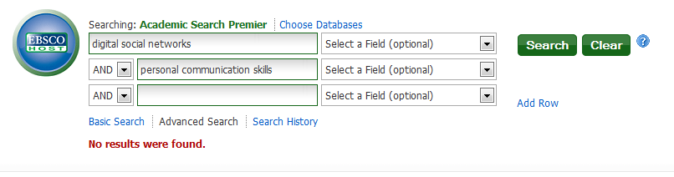
You could just search this in Academic Search Premier, but the results are disappointing:

Slide 26
Expand your vocabulary
Get more and better results by:
  Brainstorming and listing synonyms, examples, and related concepts for each keyword and phrase.
  Use personal experience, class notes, reference databases (such as Gale Virtual Reference Library or Credo) or internet search engines such as Google to discover synonyms and related concepts

Slide 27
Expand your vocabulary
Digital social networks
  Synonyms: online social networks
  Examples: Facebook, twitter
  Related concepts: social media
Personal communication skills
  Synonyms: face-to-face
  Examples: Talking, listening, eye contact, body language, non-verbal communication
  Related concepts: Emotional intelligence

Slide 28
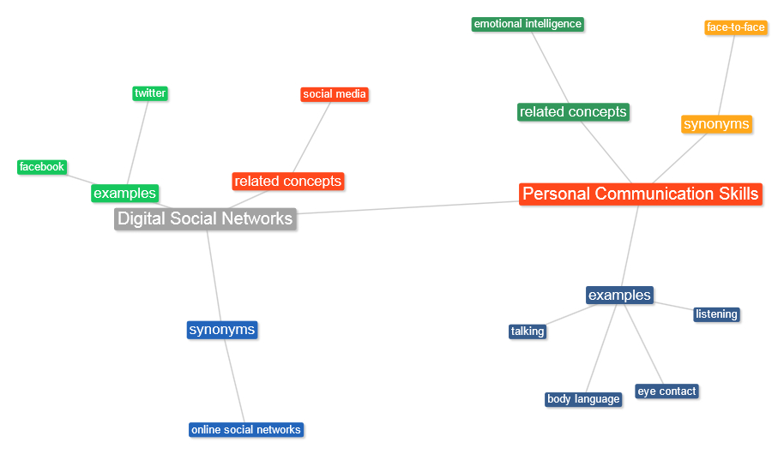
Keyword Mind-Map View

Slide 29
Keyword List View
Synonyms are other terms or ways of expressing your keywords. Related concepts may be broader or narrower than your keyword.
Keywords | Synonyms/examples | Related concepts
Digital social networks | Online social networks, Facebook, twitter | Digital media, communications technology, privacy
Personal communication skills | Talking, listening, eye contact, etiquette, body language, non-verbal communication | Emotional intelligence

Slide 30
Keywords to Search terms
Combine your keywords into search queries
Use Booleans (AND, OR, NOT)
You may or may not want to search related concepts, depending on the topic and number of results
Keywords | Synonyms/examples | Related concepts
Digital social networks | Online social networks, Facebook, twitter | Digital media, communications technology, privacy
Personal communication skills | Talking, listening, eye contact, etiquette, body language, non-verbal communication | Emotional intelligence
OR
OR
AND

Slide 31
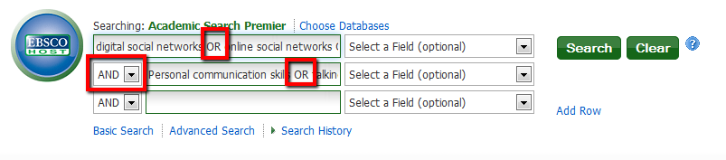
Search Queries
Use OR to connect synonyms and examples
  (digital social networks OR online social networks OR facebook OR twitter)
  (Personal communication skills OR talking OR listening OR eye contact OR etiquette OR body language OR non-verbal communication)
Use AND to connect these two:
  (digital social networks OR online social networks OR facebook OR twitter) AND
  (Personal communication skills OR talking OR listening OR eye contact OR etiquette OR body language OR non-verbal communication)

Slide 32
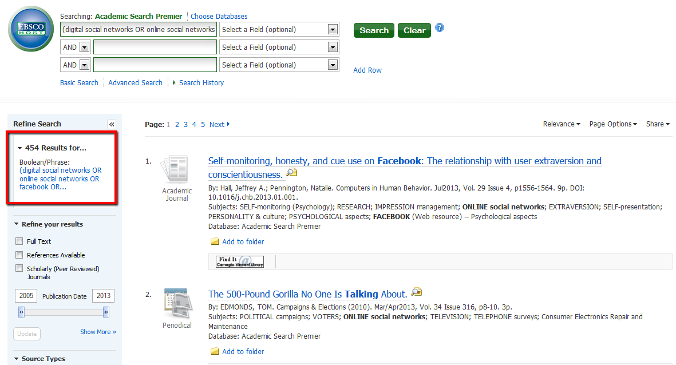
Better Results!

Slide 33
Keywords
Combine synonyms with OR
drug abuse AND teenagers …
known as brief search…
drug abuse OR substance abuse AND teenagers OR adolescents …
known as a building block search

Slide 34
Search Techniques
Several techniques for database, catalog and Internet searches include:
3M/Boolean techniques
Truncation and Wildcards
Phrase Searching

Slide 35
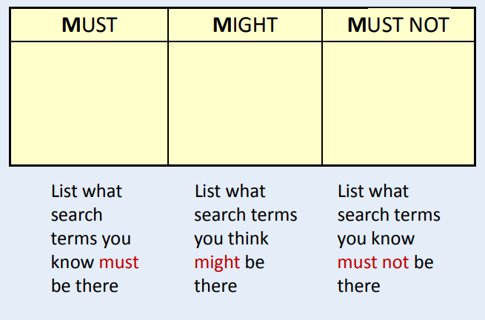
The 3M Search Strategy (Boolean)

Slide 36
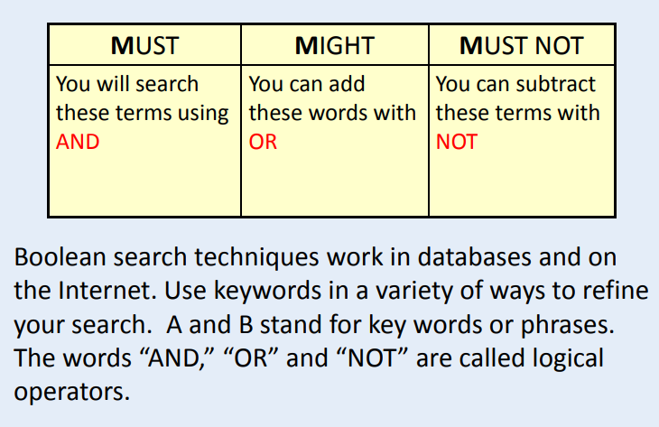
The 3M Search Strategy (Boolean)

Slide 37
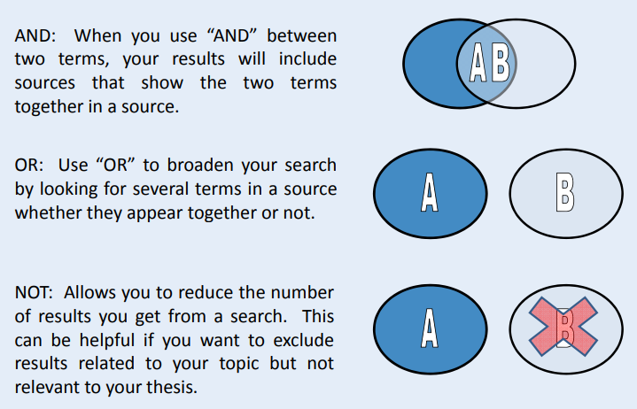
Boolean Search

Slide 38
Truncation/Wildcards/Phrase
To get the best results when searching, you have to include all the variations of a word in your search. This can be frustrating as it means entering singular and plural versions, words that begin with the same stem or root, and words that can be spelt in various ways!
Then there’s the problem of keeping phrases together, so that you get an exact match rather than random instances of your keywords.
The solution? Use wildcards, truncation and phrase searching!

Slide 39
Truncation
Use the root of a word to broaden your search responses.
Using the root Psych* will result in the following:
  Psychology
  Psychological
  Psychologist
  Psychiatry
  Psychiatrist

Slide 40
Truncation
Use the root of a word to broaden your search responses.
Using the root Comput* will result in the following:
  Computer
  Computing
  Computerize
  Computation
  Computerization
  Truncation symbols vary from database to database so always check the help. Common symbols used are *, $, #.

Slide 41
Wildcards
A question mark (?) may be used to represent a single character, anywhere in the word. It is most useful when there are variable spellings for a word, and you want to search for all variants at once. For example, searching for colo?r would return both color and colour.
organi?ation finds organization, organization
wom?n and the database will retrieve woman and women.

Slide 42
Fuzzy Searching
It is designed to find terms that are spelled incorrectly at data entry or query input
For example, the term computer could be misspelled as compter, compiter, comptuer, or compyter
“Did you mean” at Google is an example

Slide 43
Phrase Searching
Phrase Searching means searching for two or more words as an exact phrase.
In order to search for an exact phrase you must enclose the words of that phrase in quotation marks or make the appropriate choice on the database search page: “Towards a healthier Scotland”
Because phrase searches are more specific than “AND” searches, they will usually retrieve fewer records. Compare the results of these two searches in OPAC:
climate and change
“climate change”
“Climate change” finds fewer records than climate change without the quotation marks since it would not find a phrase such as change in the climate.

Slide 44
Last Words
In general, it is better to have more information than too little
Look for a variety of materials
Use a variety of keywords
Look at the works authors use in their resource lists
Use general and specific databases
Plan for enough time to return to research in case your approach changes or you need more information

Slide 46
Thank You for your patience

Slide 47
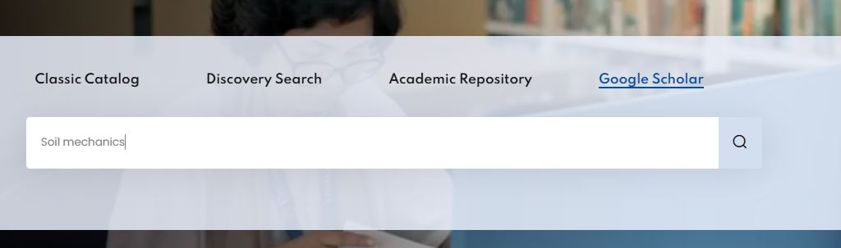
Library Website
https://library.uttarauniversity.edu.bd

Slide 49
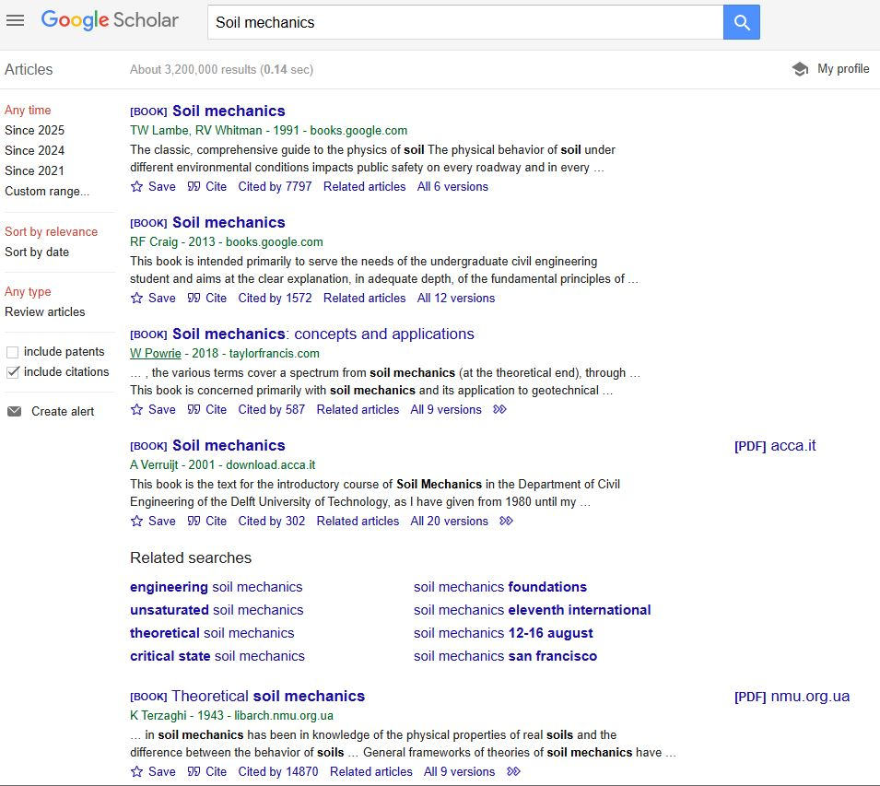
Google Scholar
https://scholar.google.com

